Slide 1
Machine Learning From Las Vegas: Analyzing big datasets of online reviews for improved placemaking guidelines
Yang Song, Evan Lecy, Dominic Fischer, Runzi Wang

Slide 2
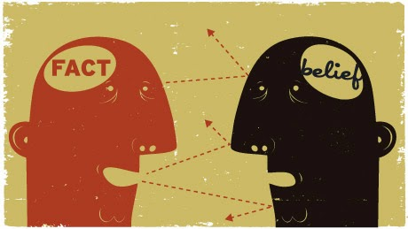
Urban design Considerations
Needs, Concerns and Situations in Public domains.
How we know our design intervention is what the public wants?
Designers’ bias + limitations to serve a broad spectrum of people(Dobbins, 2009)
Notes:
We as urban designers are dealing with issues in public domains. We often need to understand what are the needs, concerns and situations of the cities we are looking at? And we usually have a question is how we know our design intervention is what public wants? does our fact and belief match?

Slide 3
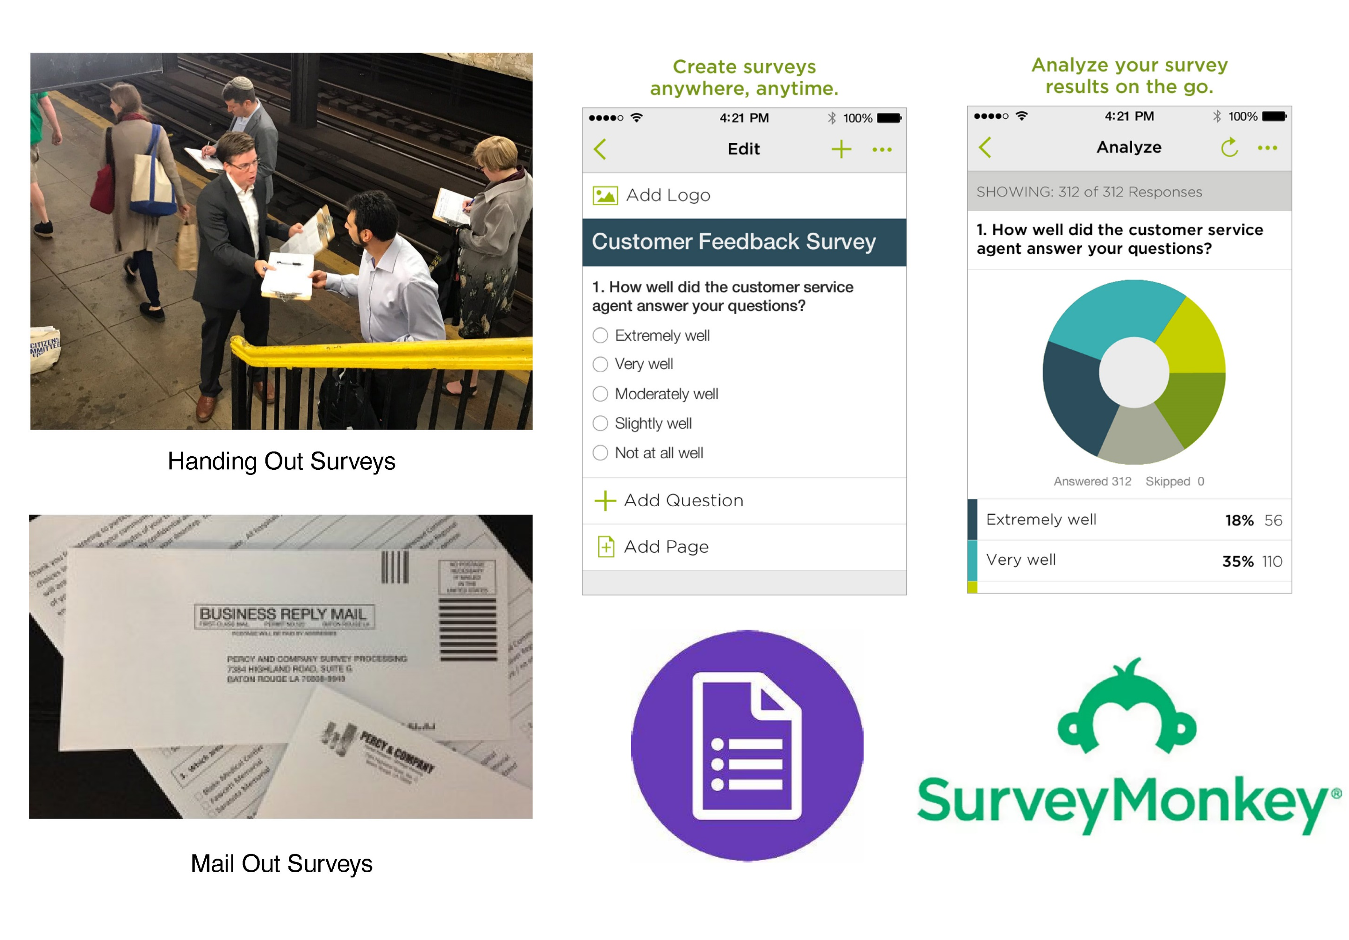
Public Meetings/surveys/fieldworks
Needs, Concerns and Situations in Public domains.
How we know our design intervention is what the public wants?
Designers’ bias + limitations to serve a broad spectrum of people(Dobbins, 2009)

Slide 4
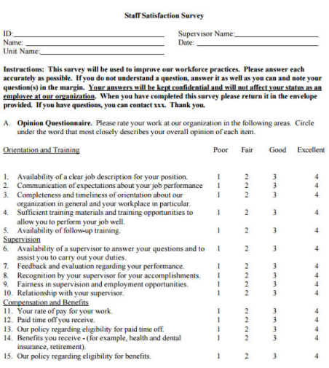
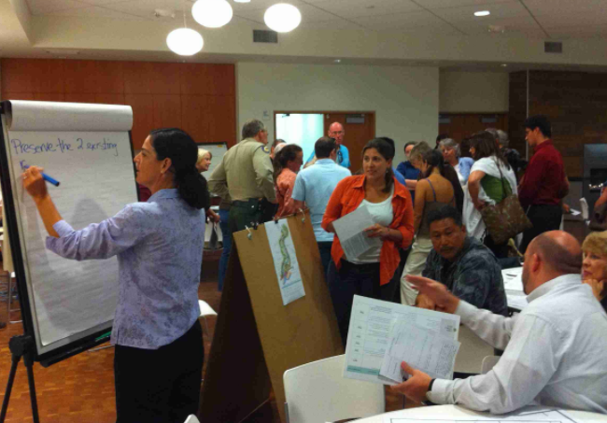
Public Meetings/surveys/fieldworks
Oversimplification issues (pre-conceived categories represents a biased and overly simple view of reality)
Validity and reliability of results (inconsistency of collected data can be attributed either to the dynamic and genuine variability or fleeting occurrence of the phenomenon observed, or to the lack of truth or consistency in the replies given) (Duncan, 1992)
Notes:
To understand urban conditions, we have to go out there and learn what are the really urban conditionis. Currently, methods like public meetings, surveys, or fieldworks are well established and used. They are really effective ways to collect data for design and research. However, two systematic issues usually exist.
First is oversimplification; pre-conceived categories represents a biased and overly simple view of reality. Few personalization,
Second is validity and reliability of results.. culture and values of the respondent, consistency of replies, whether or not you have careful responses. Dishonesty..hidden agenda..etc.
Again I am not criticizing this.. I just would like to say nothing is perfect, every approach has its benefits and drawbacks..

Slide 5
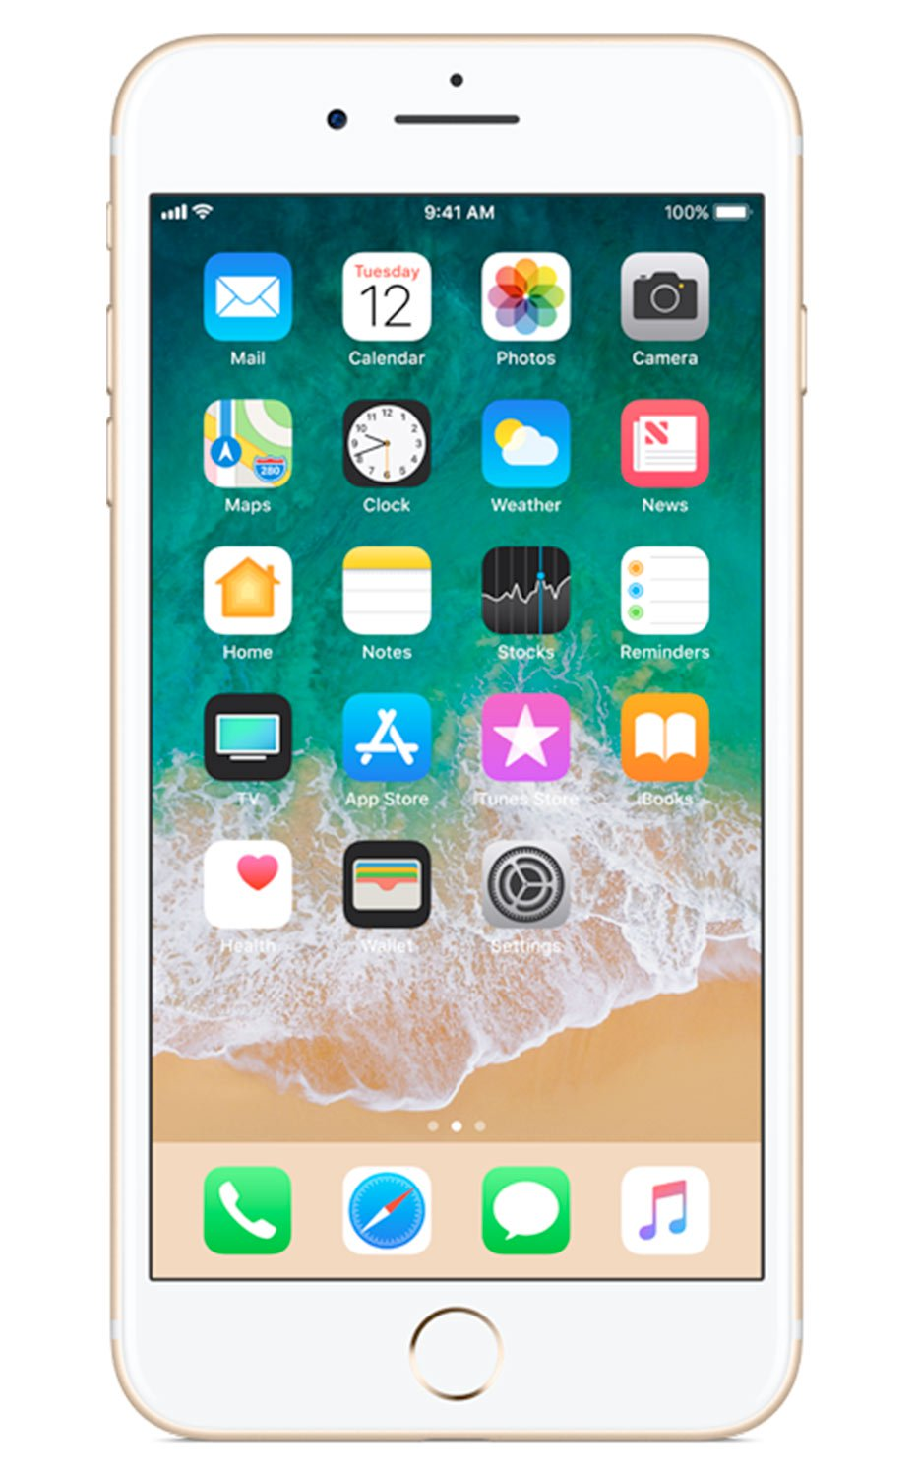
Big Data approach (crowdsourcing)
The abundance of social media, smart phones, sensors, and the internet all sense, share and process data around the world. People are increasingly able to search, aggregate, and analyze data with the exponential increase of volume, velocity and variety of data available (Chandler, 2015).
Big data technologies have been widely adopted in a variety of industries including finance, marketing, energy, telecommunications, agriculture, and real estate to make more informed decisions, as well as to be able to predict trends.
Notes:
We all have mobile phones, it becomes part of us. 开始读ppt。。。。

Slide 6
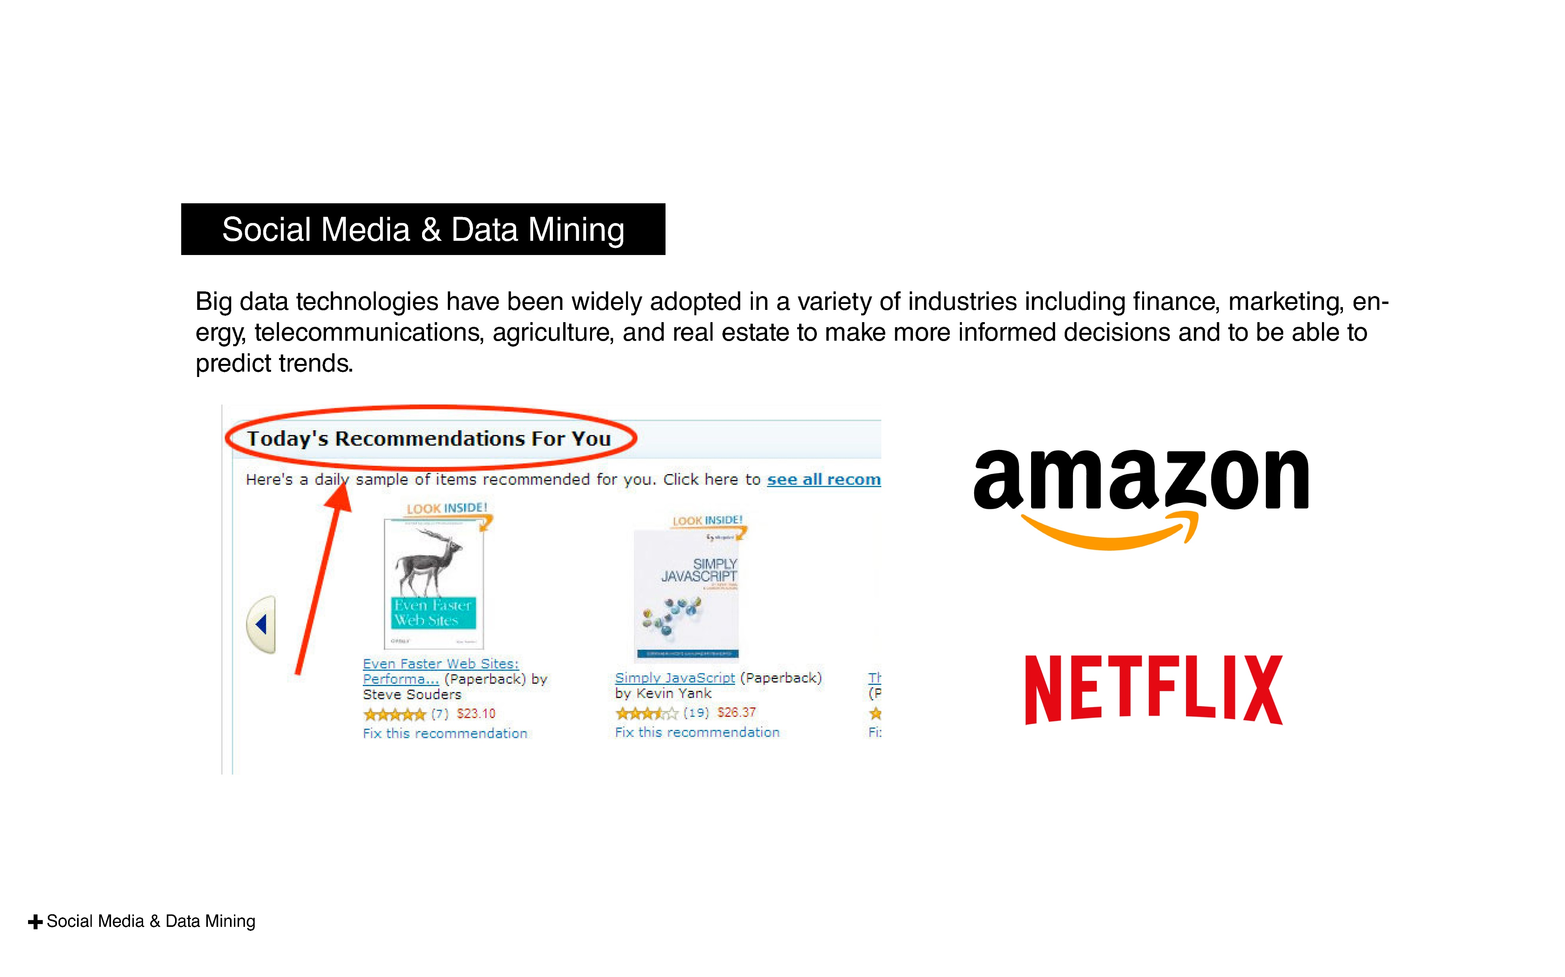
Introduction

Slide 7
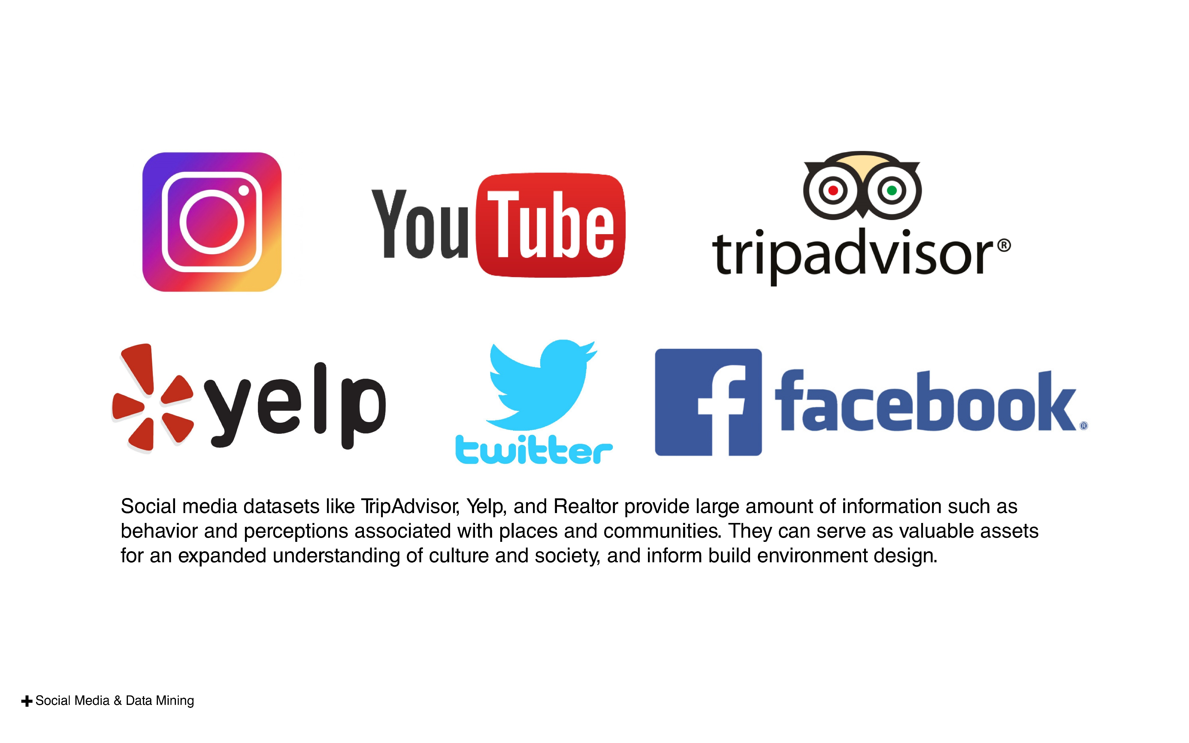

Slide 8
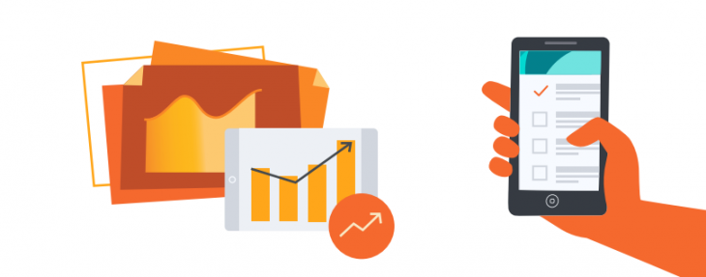
I Tweet, Therefore I Am
Social media has everything to do with self-presentation. the act of tweeting is born from individual contributions and sociologically speaking, is about self-production.
To post regularly becomes a meaningful part of users’ identities
Posted content are usually stored in our deep memory.
(Boon and Sinclair, 2009; Nosko et al., 2010).
Notes:
You know, Amazon use reviews and comments to predict best products for their customers.. Netflix recommends best movies.. Pandora make suggestions for the music you want to hear… Most importantly, they are able to change when we change. Because there are new data coming out every seconds..

Slide 9
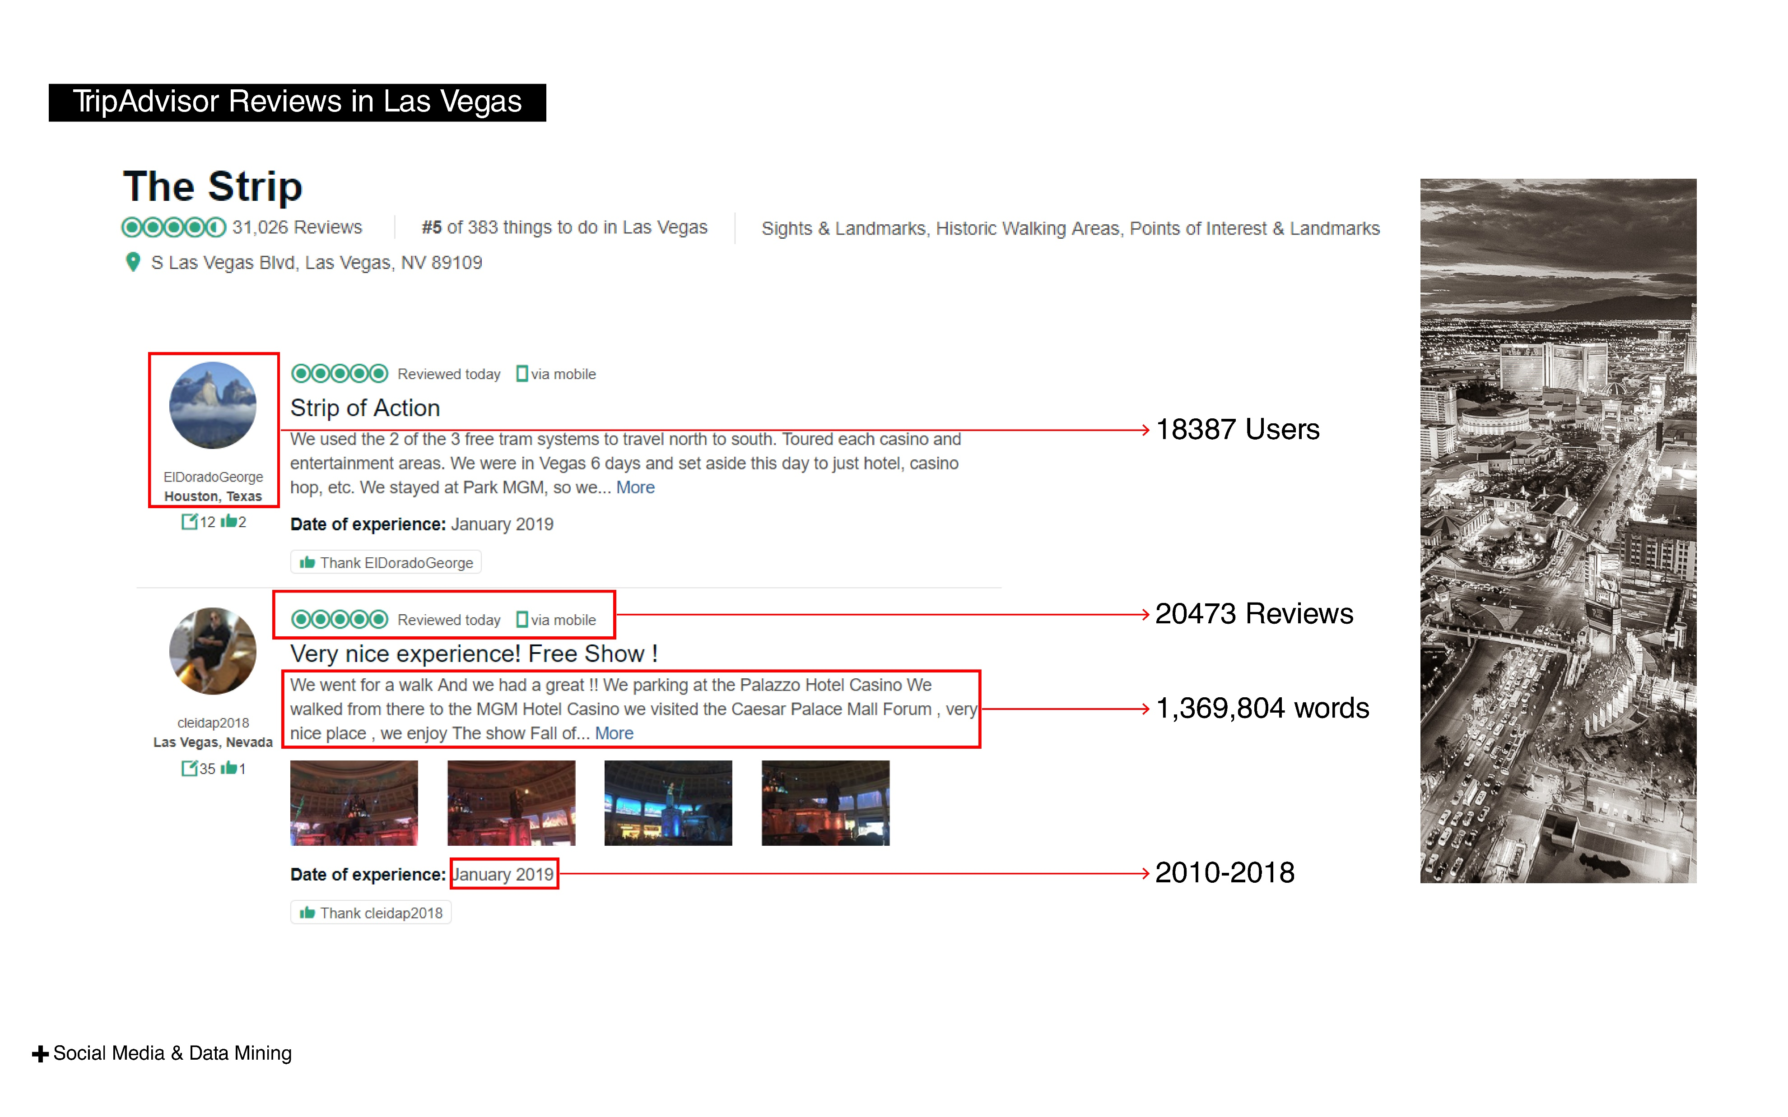
Notes:
You know, Amazon use reviews and comments to predict best products for their customers.. Netflix recommends best movies.. Pandora make suggestions for the music you want to hear… Most importantly, they are able to change when we change. Because there are new data coming out every seconds..

Slide 10
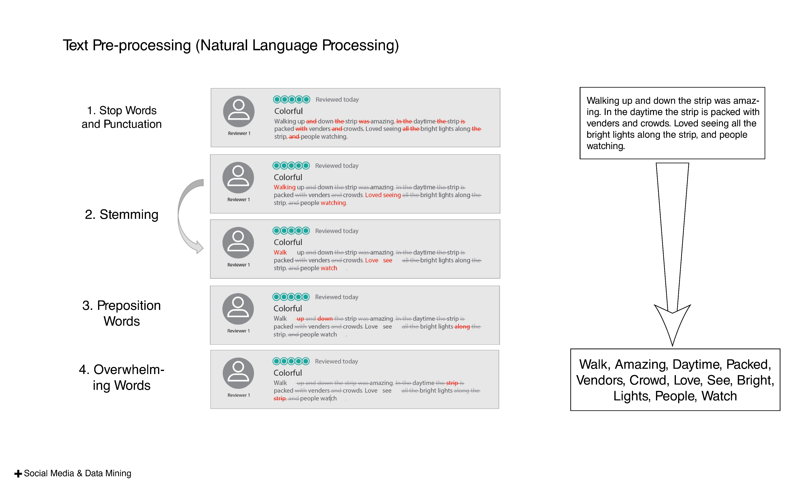
Notes:
You know, Amazon use reviews and comments to predict best products for their customers.. Netflix recommends best movies.. Pandora make suggestions for the music you want to hear… Most importantly, they are able to change when we change. Because there are new data coming out every seconds..

Slide 11
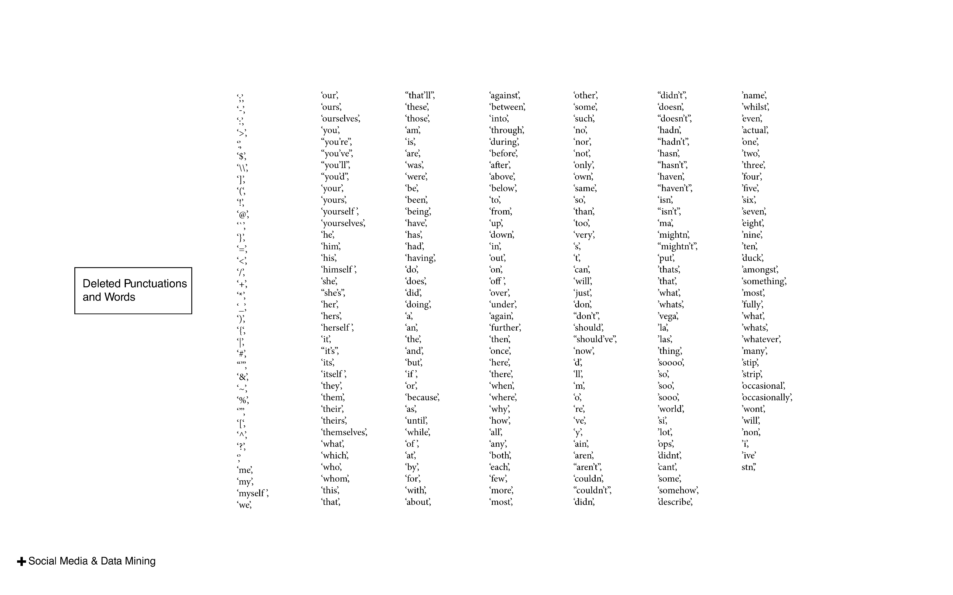
Notes:
You know, Amazon use reviews and comments to predict best products for their customers.. Netflix recommends best movies.. Pandora make suggestions for the music you want to hear… Most importantly, they are able to change when we change. Because there are new data coming out every seconds..

Slide 12
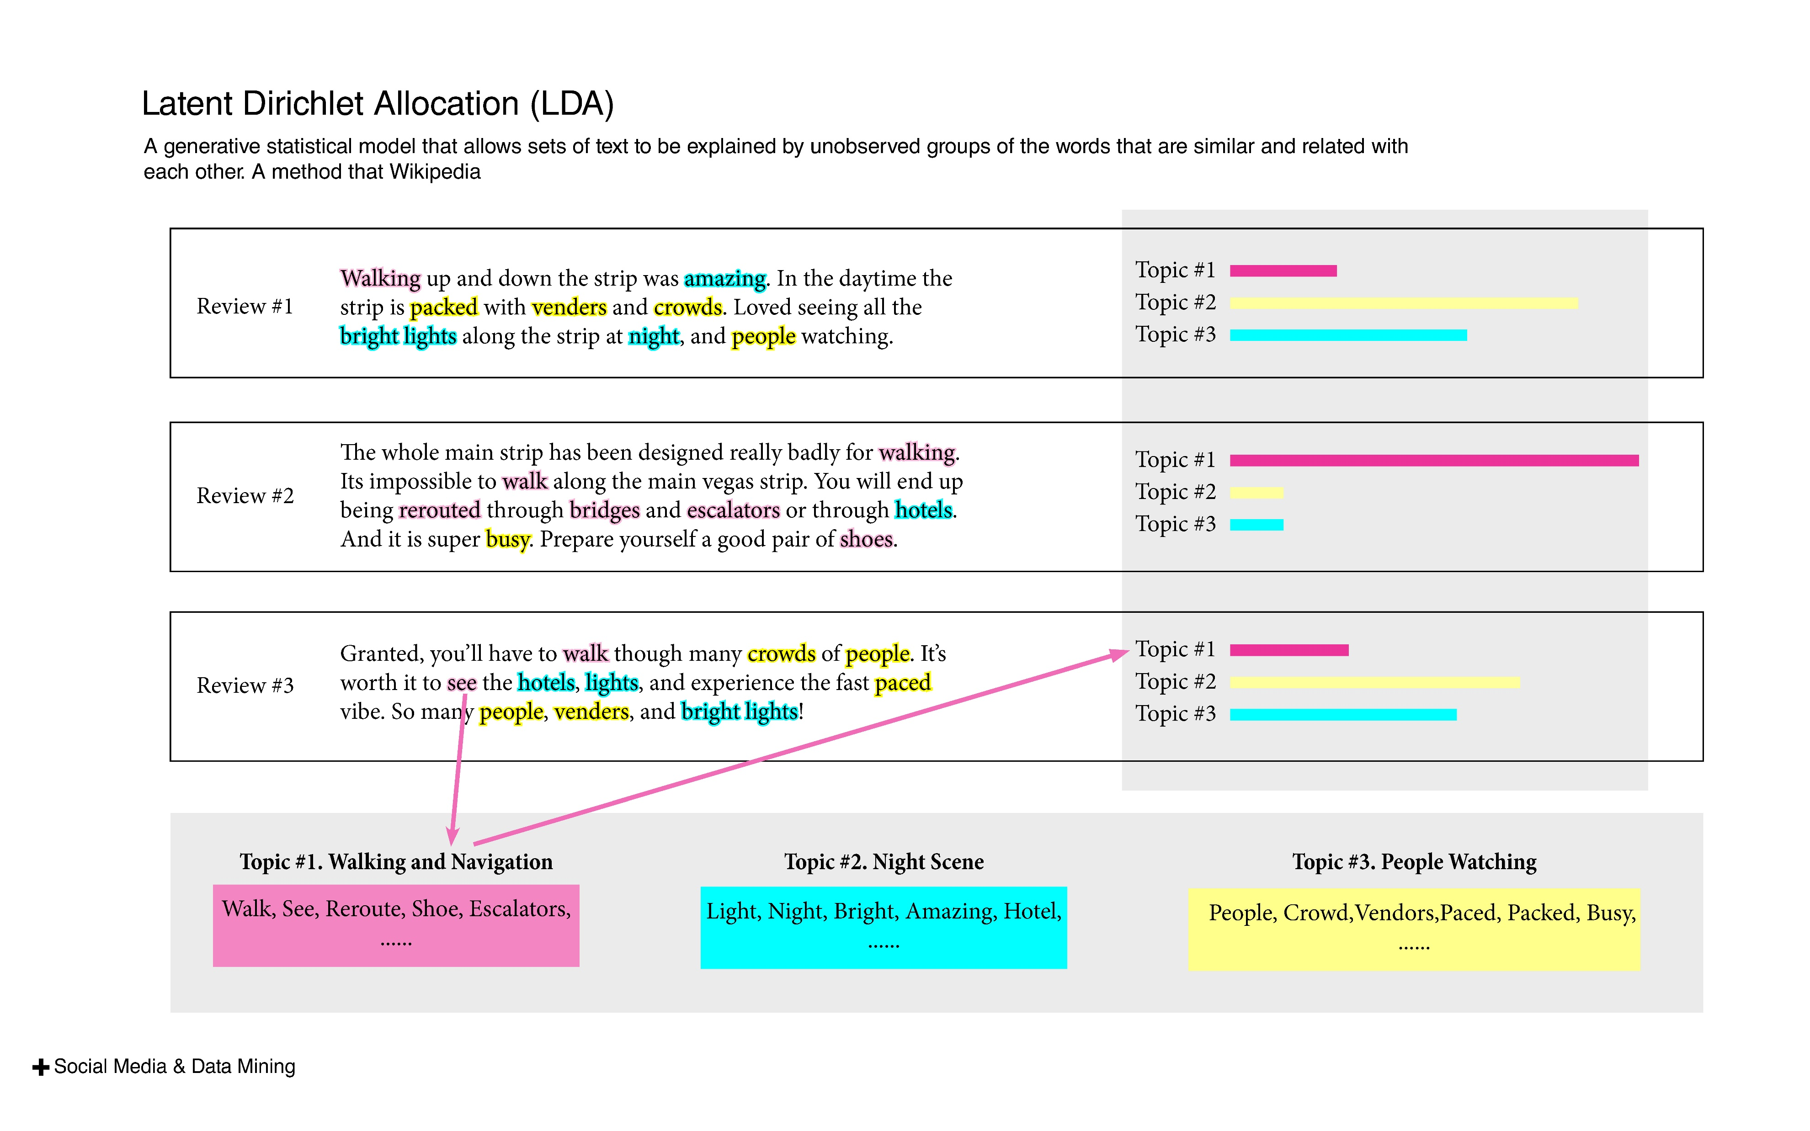
Notes:
You know, Amazon use reviews and comments to predict best products for their customers.. Netflix recommends best movies.. Pandora make suggestions for the music you want to hear… Most importantly, they are able to change when we change. Because there are new data coming out every seconds..

Slide 13
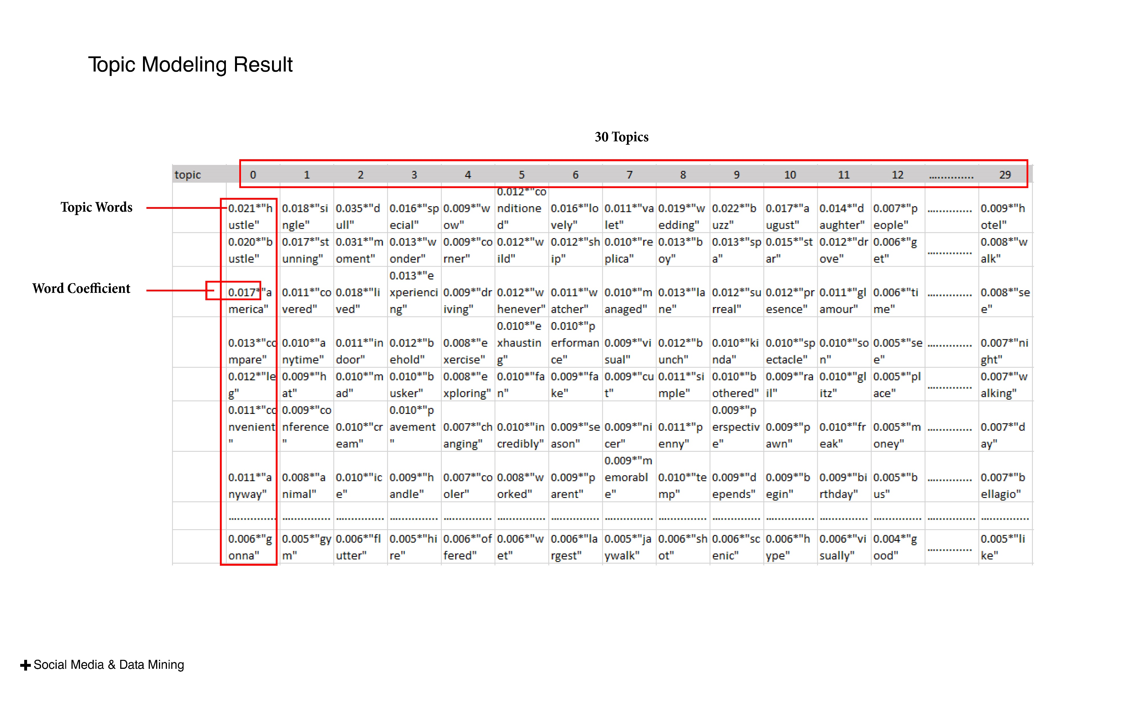
Notes:
You know, Amazon use reviews and comments to predict best products for their customers.. Netflix recommends best movies.. Pandora make suggestions for the music you want to hear… Most importantly, they are able to change when we change. Because there are new data coming out every seconds..

Slide 14
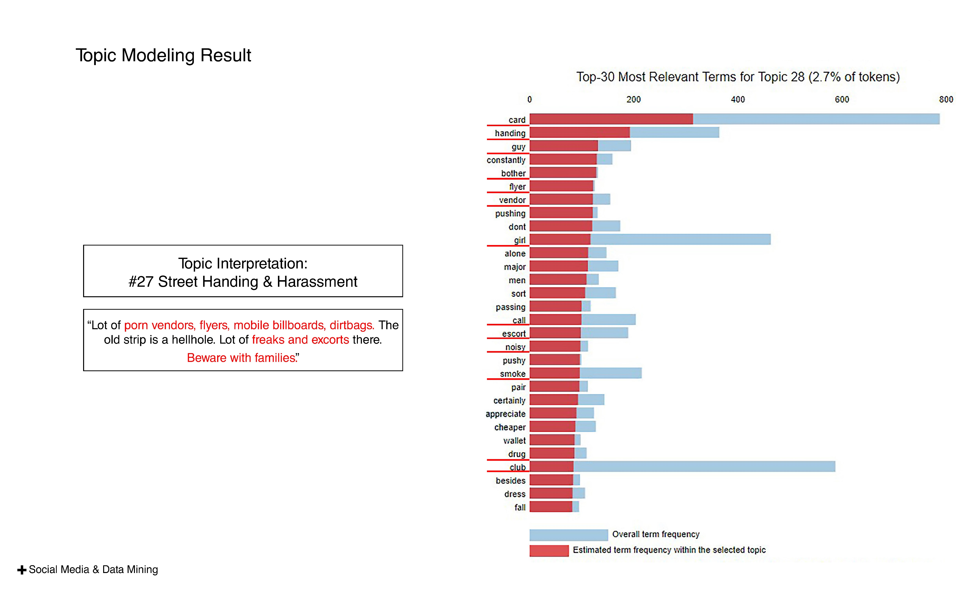
Notes:
You know, Amazon use reviews and comments to predict best products for their customers.. Netflix recommends best movies.. Pandora make suggestions for the music you want to hear… Most importantly, they are able to change when we change. Because there are new data coming out every seconds..

Slide 15
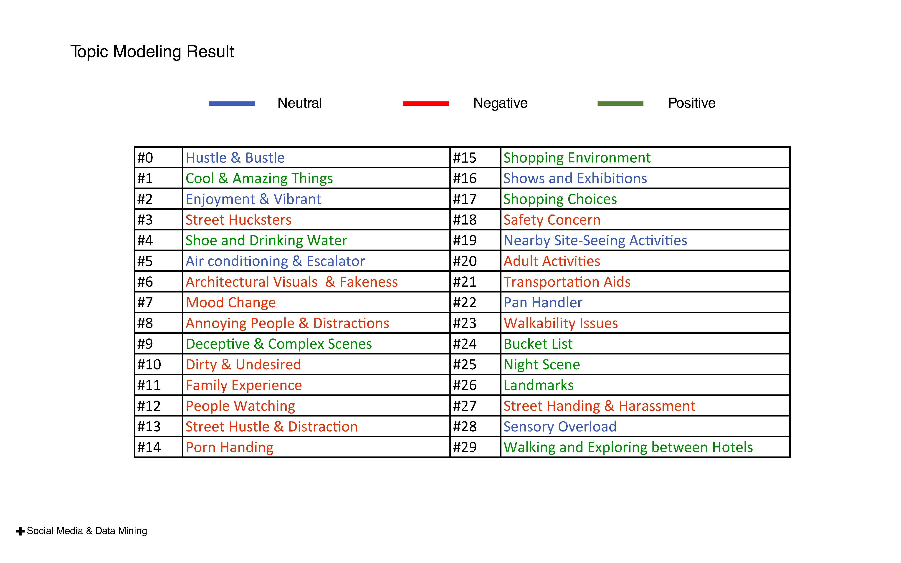
Notes:
You know, Amazon use reviews and comments to predict best products for their customers.. Netflix recommends best movies.. Pandora make suggestions for the music you want to hear… Most importantly, they are able to change when we change. Because there are new data coming out every seconds..

Slide 16
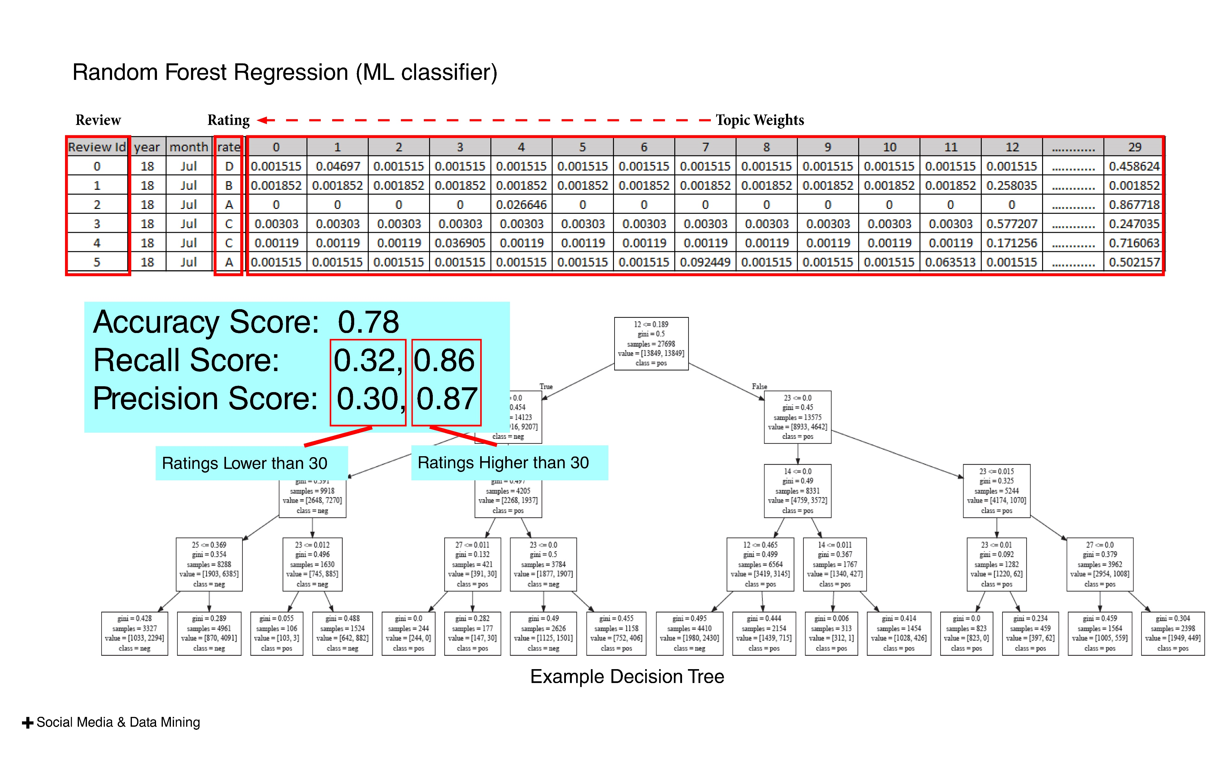
Notes:
You know, Amazon use reviews and comments to predict best products for their customers.. Netflix recommends best movies.. Pandora make suggestions for the music you want to hear… Most importantly, they are able to change when we change. Because there are new data coming out every seconds..

Slide 17
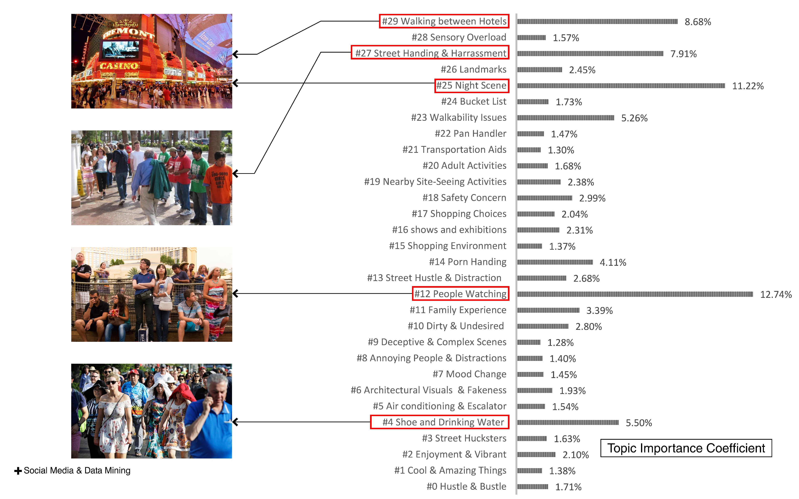
Notes:
You know, Amazon use reviews and comments to predict best products for their customers.. Netflix recommends best movies.. Pandora make suggestions for the music you want to hear… Most importantly, they are able to change when we change. Because there are new data coming out every seconds..

Slide 18
! Thank You !
Notes:
You know, Amazon use reviews and comments to predict best products for their customers.. Netflix recommends best movies.. Pandora make suggestions for the music you want to hear… Most importantly, they are able to change when we change. Because there are new data coming out every seconds..

